Slide 1

Traffic Prediction Dataset

Slide 2
Dataset Overview
The dataset consists of traffic flow information collected over a period of two months .
It contains 5952 records with 9 columns.
The data includes vehicle-wise traffic count such as Cars, Bikes, Buses, Trucks. It also include date, time and day information.
The data set has 3 categorical and 6 numerical columns.
This dataset is suitable for Traffic analysis and Traffic situation prediction.

Slide 3
Simple description of each column in your dataset:
Time: Time at which traffic data was recorded
Data: Date of traffic observation
Day of the week: Day on which traffic was recorded
CarCount: Number of cars observed
BikeCount: Number of bikes observed
BusCount: Number of busses observed
TruckCount: Number of truck observed
Total: Total number of vehicles recorded
Traffic Situation: Traffic condition category (such as Low, Normal, or Heavy).

Slide 4
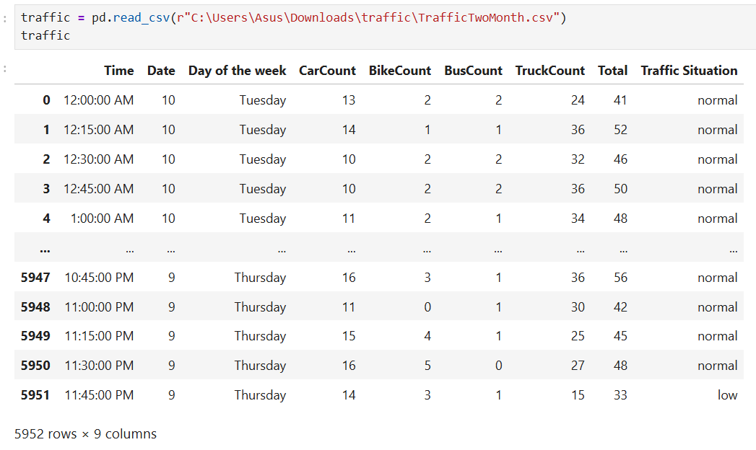
Reading Dataset

Slide 5
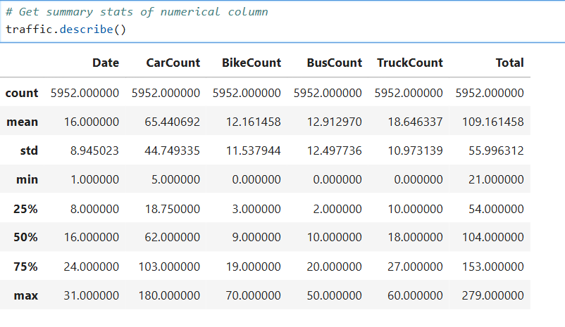
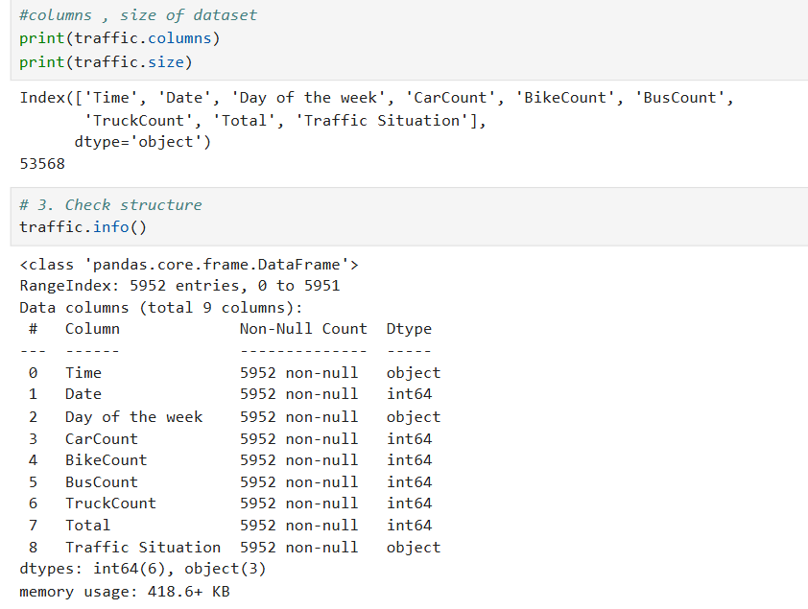
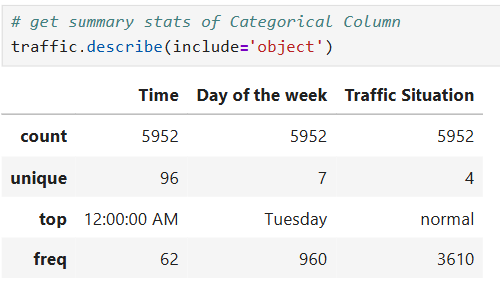
Basic checks

Slide 6
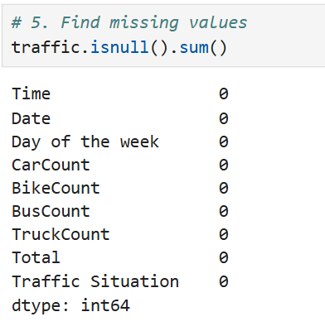
Preprocessing Techniques on Dataset Individual Columns
Checking missing values
There are No missing values in the dataset.There are no missing values in the dataset.
All columns have 2,976 non-null entries.
There may be outliers in vehicle count columns due to peak-hour traffic.
The Date column is stored as an integer and may need conversion to a proper datetime format for time-series analysis.

Slide 7
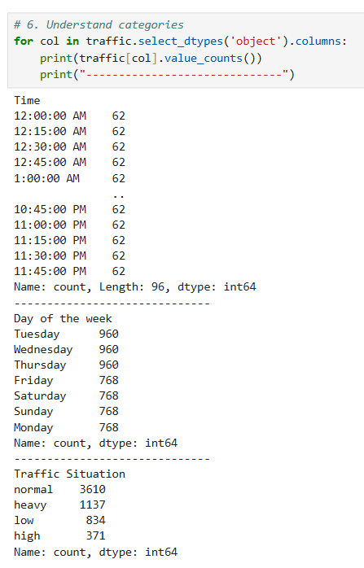
Understanding Categorical Data
We obtained all the unique values and their counts for the categorical columns.
Day of the week:
Tuesday: 960
Wednesday: 960
Thursday: 960
Friday: 768
Saturday:768
Sunday: 768
Monday: 768

Slide 8
Finally, from Phase 1 (Data Understanding), the following insights were obtained:
The dataset contains 5,952 rows and 9 columns
There are 3 columns with categorical data and 6 columns with numerical data.
The categorical columns are: Time, Day of the week, and Traffic Situation
The numerical columns are: Date, CarCount, BikeCount, BusCount, TruckCount, and Total.
The Date and Time columns together act as temporal identifiers indicating when traffic data was recorded.
There are no missing values in the dataset.
There may be outliers in vehicle count columns due to peak-hour or unusual traffic conditions.
Traffic Situation can be considered the target variable for traffic classification or prediction tasks.
All vehicle count columns are stored in numeric format, making them suitable for analysis.

Slide 9
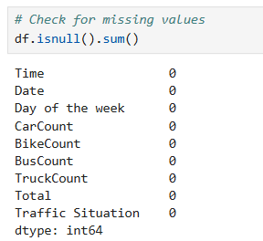
Handling Missing Data
Insights
No missing values were found in the dataset.
Therefore, no imputation or removal is required.

Slide 10
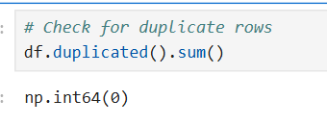
Removing duplicates
Insights
No duplicate records were found in the dataset.
No rows were removed.

Slide 11
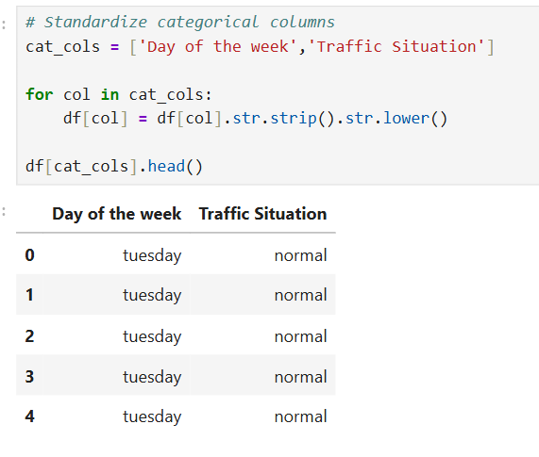
Fix Inconsistencies in Categorical Data
Insights
Case and whitespace inconsistencies were fixed.
Categories are now standardized.
Insights: There are no inconsistencies in the text data.

Slide 12
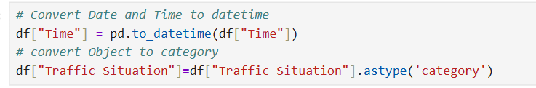
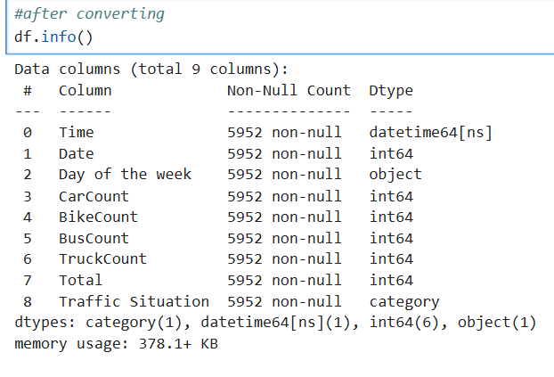
Convert data types
Insights
Time is converted to datetime.
Traffic Situation is converted to category dtype

Slide 13
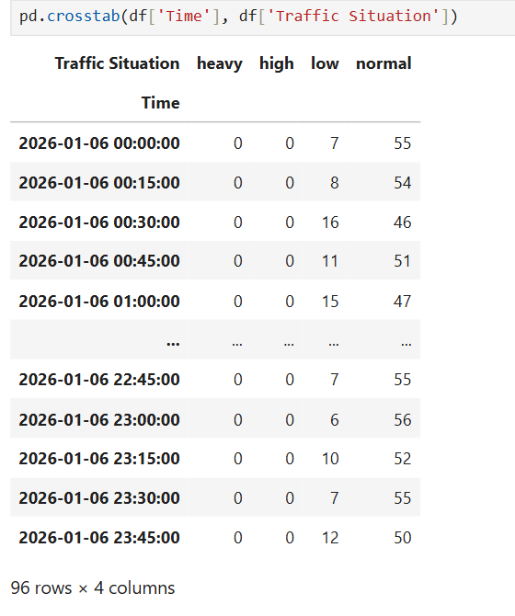
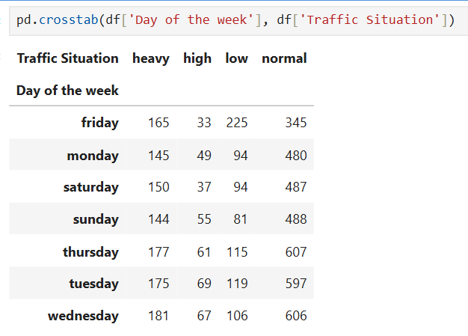
Non-Visual Bivariate Analysis
Categorical vs Categorical
Insights
The crosstab between Day of the week and Traffic Situation shows how traffic conditions vary across different days.
Certain days exhibit a higher frequency of heavy traffic compared to others.
The crosstab between Time and Traffic Situation highlights how traffic conditions change across different time periods.
Heavy traffic tends to occur more frequently during specific times of the day.

Slide 14
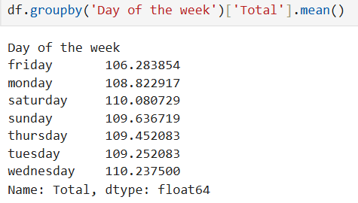
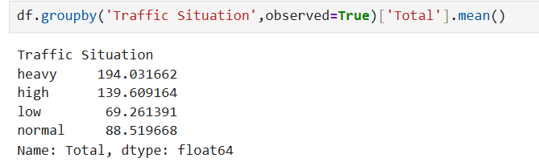
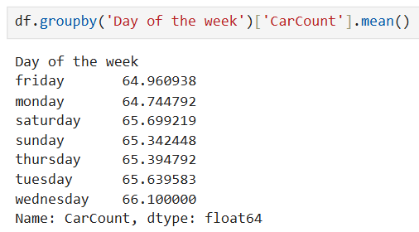
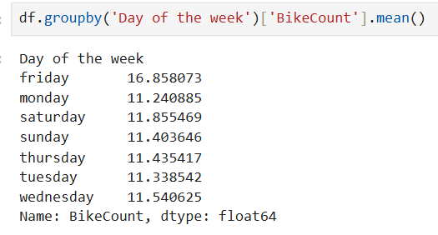
Categorical vs Numerical

Slide 15
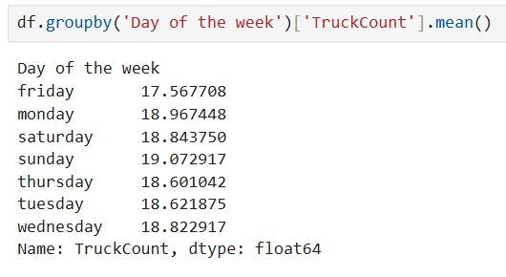
Categorical vs Numerical
Insights
Traffic Situation vs Total:
The average total traffic increases from low to heavy traffic situations, confirming that traffic situations accurately reflect overall traffic volume.
Day of the Week vs Total:
The mean total traffic varies across days, indicating that certain days experience higher traffic levels than others.
BikeCount by Day:
Average bike traffic shows noticeable variation across days, suggesting changes in bike usage depending on the day of the week.
CarCount by Day:
Car traffic exhibits significant variation across days, reinforcing that cars are the dominant contributors to daily traffic volume.
TruckCount by Day:
Truck traffic remains relatively lower and more stable across

Slide 16
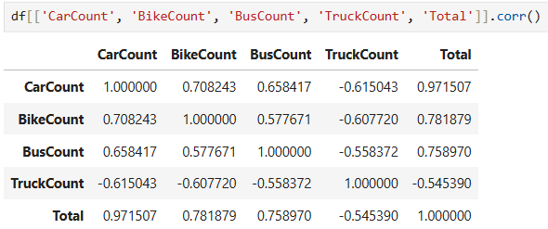
Numerical vs Numerical
Insights
CarCount vs Total:
CarCount shows a strong positive correlation with Total, indicating that an increase in car traffic significantly increases overall traffic volume.
BikeCount vs Total:
BikeCount has a moderate positive correlation with Total, suggesting that bike traffic contributes to total traffic but less strongly than cars.
TruckCount vs Total:
TruckCount shows a weak to moderate positive correlation with Total, indicating that trucks add to traffic volume but are not the dominant contributors.
BusCount vs Total:
BusCount has a weak correlation with Total, suggesting that buses have a minimal impact on overall traffic levels.

Slide 21
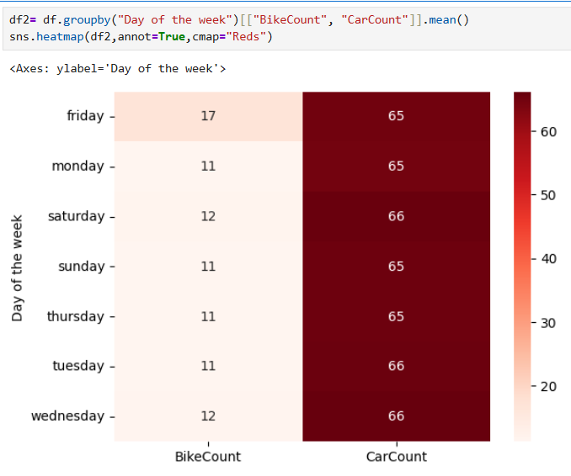
Multivariate Analysis
Insights:
CarCount is consistently higher than BikeCount across all days of the week.
Darker color intensity for CarCount on weekdays indicates higher traffic volume.
BikeCount shows relatively stable values throughout the week compared to cars.
A slight increase in BikeCount can be observed on weekends.
Overall traffic patterns are strongly influenced by weekday.

Slide 22
Conclusion:
The dataset is clean with no missing or duplicate values.
Categorical inconsistencies were resolved.
Data types were corrected for efficient analysis.
Bivariate analysis revealed meaningful traffic patterns.
The data is ready for further analysis or modeling.

Slide 23

THANK YOU

